Slide 1
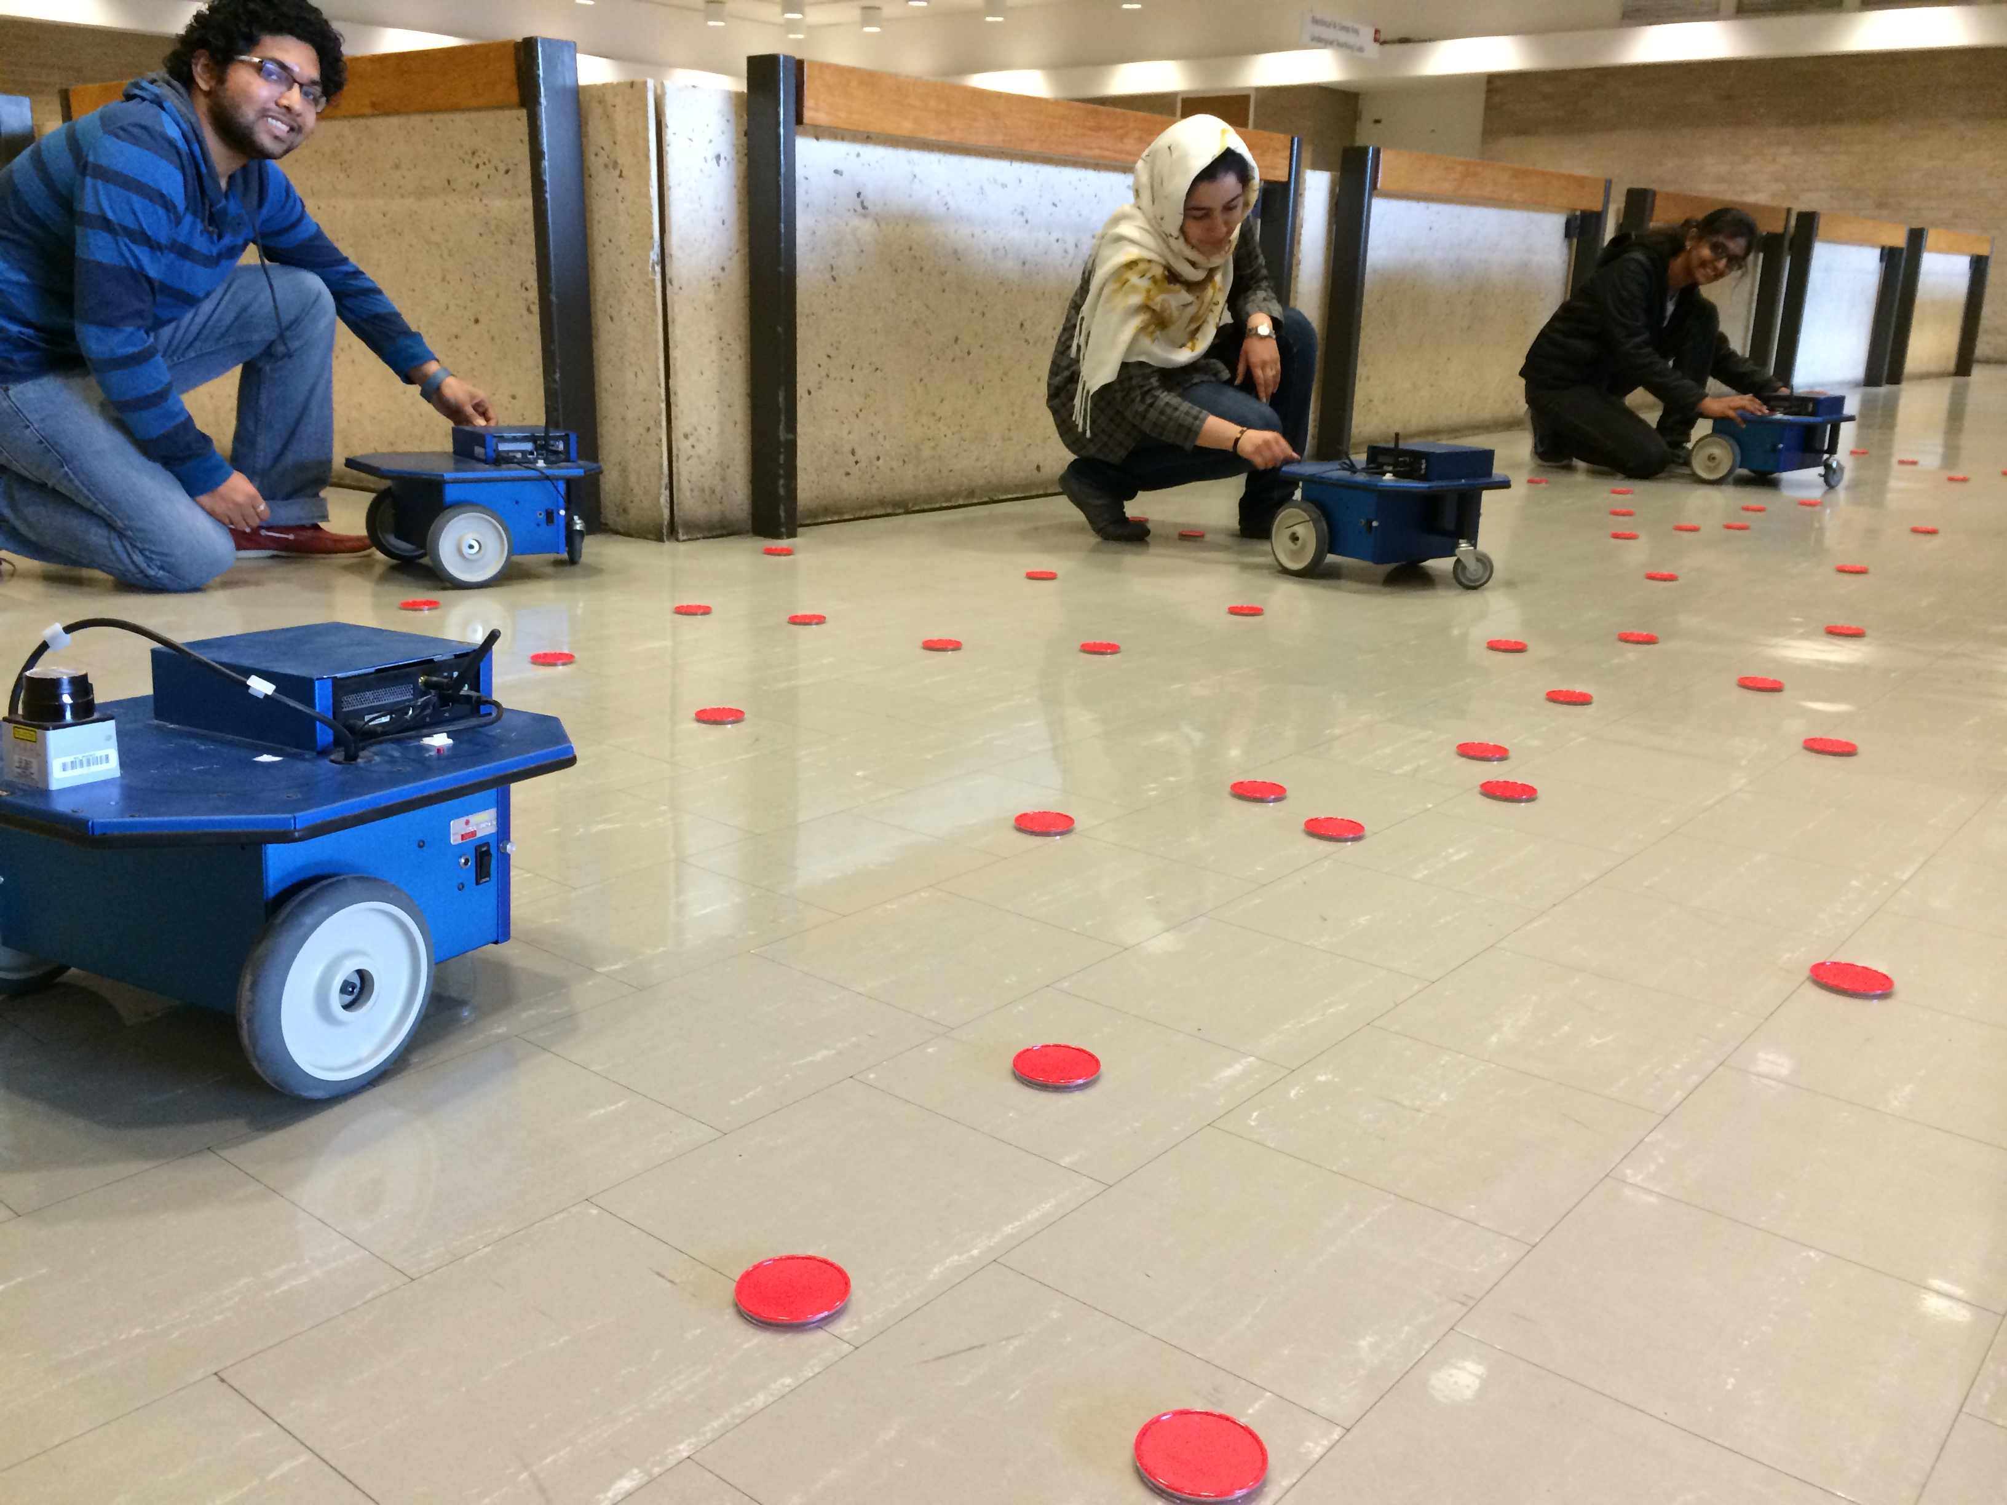



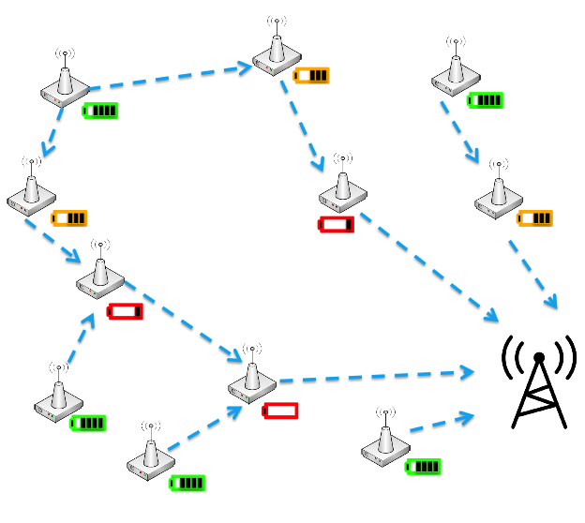
Routing Robots to Maintain Wireless Sensors by Controlling Waypoints
Robotics + Control + Path Planning
Srikanth K.V.S, Aaron T. Becker
skvenkatasudarshan@uh.edu, atbecker@uh.edu
Department of Electrical & Computer Engineering
University of Houston
MATLAB code
YouTube
Problem
Solution
Results
An ideal wireless sensor network (WSN) would last for decades but energy is the major impediment to sustainability. Traditional disposable batteries cannot sustain such a network.
A robot swarm maintains the sensor nodes. Maintaining includes charging nodes and collecting a part of the data that needs to be transferred to the sink, reducing the energy burden on the sensor. The robots deliver the collected data at the sink location and recharge themselves.
A Hilbert’s space-filling curve is used as the initial path. A stationary waypoint is set at the sink location (0,0). A Voronoi Diagram is used to distribute sensors among path waypoints.
Gradient descent is used to optimize the path. After 100 iterations the path has reached a local minimum. However, the resulting path has many loops.
These waypoints are loaded to a mTSP solver (multiple-Travelling Salesman Problem) to improve the gradient descent solution. The graph results after 200 iterations. Note that the waypoint positions have not changed, but the waypoint ordering has removed loops.
The mTSP solver solution is again optimized by gradient descent. An better local minimum is discovered. This process can be iterated as time permits.
Matlab simulation available at:
http://www.mathworks.com/matlabcentral/fileexchange/49863
A UV has an associated recharging footprint and a data transfer footprint, which can be modeled as disks of radius r_{recharge} and r_{data}
Path A visits each node
Path B designed to recharge all nodes
Path C designed to transfer data to all nodes
Most energy in a WSN is consumed by
Wireless transmissions of perceived data
Long-distance multi-hop transmissions from the sensors to the sink
1.
2.
3.
4.
Path
Waypoints
Transmission
range of WSN
WSN sink
Voronoi cells

